Slide 1
CAPSTONE PROJECT
Secure Data Hiding In Images Using Steganography
Presented By:AMAN KUMAR PRAJAPATI
Student Name : AMAN KUMAR PRAJAPATI
College Name & Department : GURU NANAK COLLEGE OF ARTS,SCIENCEC & COMMERCE/BSC-IT

Slide 2
OUTLINE
Problem Statement
Technology used
Wow factor
End users
Result
Conclusion
Git-hub Link
Future scope

Slide 3
PROBLEM STATEMENT
In today's digital era, safeguarding data security and privacy is crucial. Conventional encryption techniques can be easily detected and intercepted. Our project addresses this issue by employing steganography to embed hidden messages within images. This approach creates a discret communication channel, bolstering data confidentiality without attracting attention.

Slide 4
TECHNOLOGY USED
Programming Language: Python
LIBRARIES:
OpenCV (cv2):for image processing
OS (os):A standard library module for interacting with the operating system, used for file path manipulations.
Tkinter (tk): for the GUI
Pillow (PIL):used for opening, manipulating, and saving image files.
Platform: Cross-platform (Windows/Linux)
Tools: Visual Studio Code,

Slide 5
WOW FACTORS
Next-Generation Data Security:Cutting-Edge Steganography: Seamlessly hides both passcodes and message lengths within image headers, ensuring ultra-secure data transmission.
Lossless PNG Format: Guarantees the integrity and quality of hidden data with a lossless image format.
User-Friendly Interface: Experience intuitive encryption and decryption with a sleek, modern GUI.
Advanced Image Processing: Combines powerful image manipulation with top-notch data security to create a robust solution for covert communication.

Slide 6
END USERS
This innovative image steganography tool is perfect for developers and security enthusiasts. It offers advanced, secure data transmission methods by discreetly encrypting and decrypting sensitive information within images.
With a user-friendly interface and cutting-edge image processing, it ensures seamless and secure communications without compromising usability.
Ideal for personal projects, academic research, or professional applications, this tool strikes the right balance of functionality and simplicity. Its versatility and adaptability make it suitable for a wide range of security needs, paving the way for the future of secure communication.

Slide 7
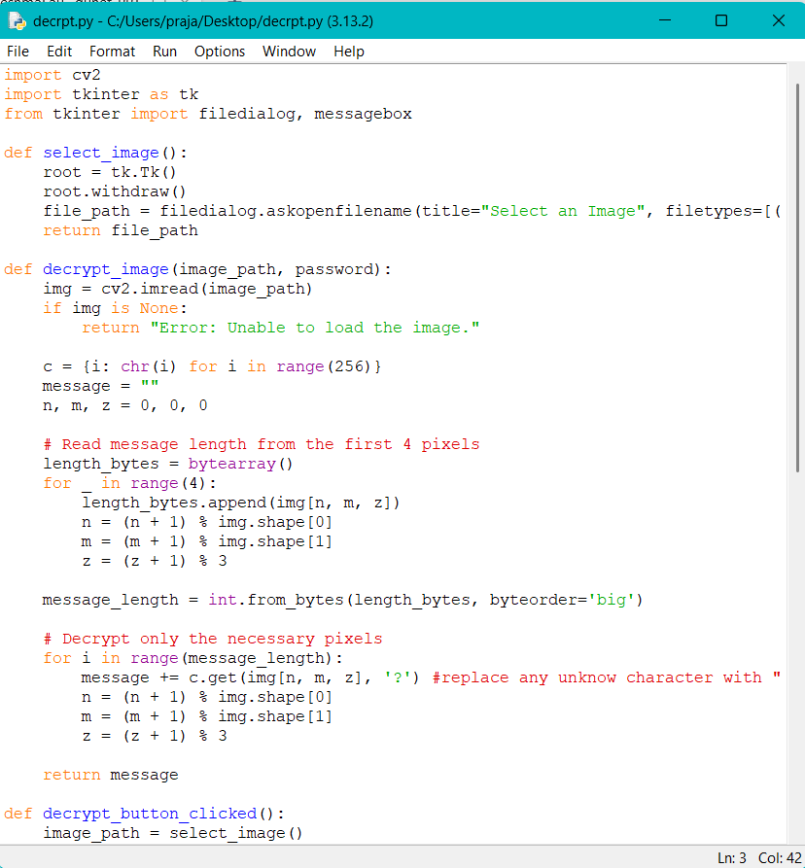
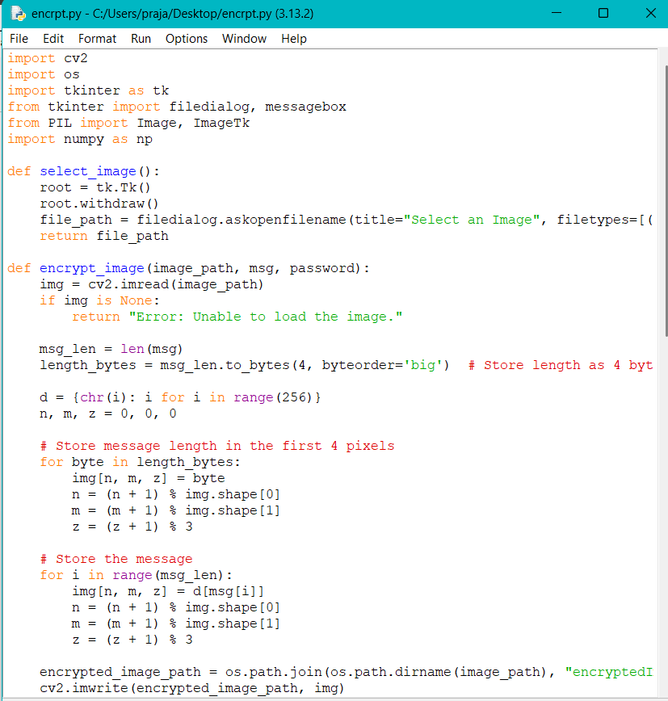
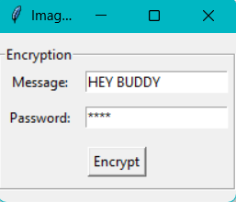
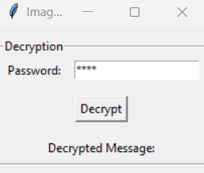

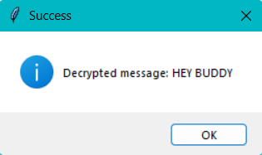
RESULTS

Slide 8
CONCLUSION
Our image steganography tool leverages advanced techniques to provide a secure and discreet method for data transmission.
By embedding sensitive information within images using LSB steganography and employing a user-friendly interface, we ensure robust data privacy and integrity.
This tool is an invaluable asset for developers and security enthusiasts, offering a balance of simplicity and functionality.
Embrace the future of secure communication with our innovative solution—where cutting-edge technology meets seamless user experience.

Slide 9
GITHUB LINK
https://github.com/Amankumar-004/Stenography-Project

Slide 10
FUTURE SCOPE(OPTIONAL)
Advanced Encryption Techniques:
Integrate more sophisticated encryption algorithms.
Implement multi-layer encryption for enhanced security.
Steganalysis Resistance:
Enhance resistance to detection methods, making hidden messages even more secure.
User Experience Improvements:
Refine the user interface for greater ease of use.
Add features such as drag-and-drop image selection and real-time previews.
Expanded File Format Support:
Support additional image formats like GIF, BMP, and TIFF.
Cross-Platform Compatibility:
Expand support to various operating systems and mobile platforms.

Slide 11
THANK YOU

